Slide 1
Equations of Motion COMP 1601
Louis D. Nel

Slide 2
Modeling Motion in Games and Simulations
Typical Mechanics Quantities:
1) Position
2) Velocity
3) Acceleration
4) Force

Slide 3
Position
Position can be described by a simple point in 2D or 3D space (we will work only in 2D)
Physics models take place in a world with dimensions (units of measure) typically:
SI units (kilogram, meter, second)
SAE units: (pound, feet, second)
To work with physics models we need to have dimension in our simulated game world.

Slide 4
Velocity
Velocity is the rate of change of position over time (units: m/sec)
Velocity can be thought to cause a change in position
Velocity can be constant or changing over time
Speed is the magnitude of a Velocity (it has no direction sense of direction)

Slide 5
Acceleration
Acceleration is the rate of change in velocity over time (units m/sec/sec or m/sec²
Acceleration can be thought to cause a change in velocity, which in turn causes a change in position.
Acceleration can be constant or changing over time
(The magnitude of acceleration does not have a special name.)

Slide 6
Force
A Force is something that can cause a change in the acceleration of an object with mass.
Units: Newton = 1 kg m/sec²
Force is related to mass by the Newton’s second law: F=ma.

Slide 7
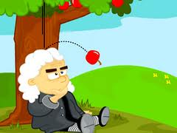
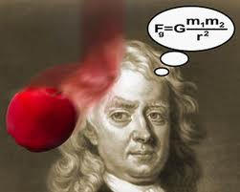
Gravitational Force
Gravitational Force is caused by virtue of objects having mass.

Slide 8
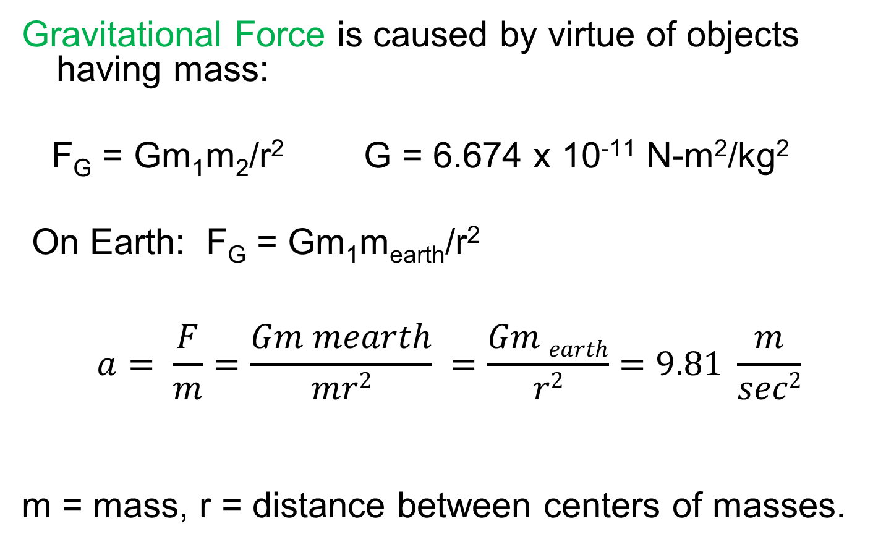
…Force
Gravitational Force is caused by virtue of objects having mass:
F_{G} = Gm₁m₂/r² G = 6.674 x 10⁻¹¹ N-m²/kg²
On Earth: F_{G} = Gm₁m_{earth}/r²
$$a= \frac{F}{m}=\frac{Gm mearth}{mr2} =\frac{Gm earth}{r2}=9.81 \frac{m}{sec2}$$
m = mass, r = distance between centers of masses.

Slide 9
Sample Calculations
Sample Calculations involving gravity
Idea: calculate what should happen based on physics equations of motion and compare that with (Euler approximation-based) simulation code.

Slide 10
Equations of Motion
These equations of motion are typically taught in high school physics. They describe the horizontal and vertical position of an object at time t given knowledge of its initial position, velocity and the constant acceleration it experiences during its travel.
x(t) = ½ a_{x}t² + v_{x0}t + x₀
y(t) = ½ a_{y}t² + v_{y0}t + y₀
Can be evaluated at any time t based only on knowing the initial conditions

Slide 11
Equations of Motion
x(t) = ½ a_{x}t² + v_{x0}t + x₀
x(t) // horizontal position at time t
a_{x} // horizontal acceleration (constant a_{x}=0)
v_{x0} // initial horizontal velocity
x₀ //initial horizontal position
y(t) = ½ gt² + v_{y0}t + y₀
y(t) // vertical position at time t
a_{y}=g // vertical acceleration (constant gravity = 9.8 m/sec²)
v_{y0} // initial vertical velocity
y₀ //initial vertical position

Slide 12
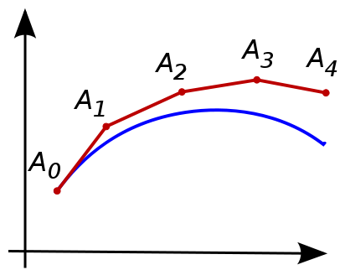
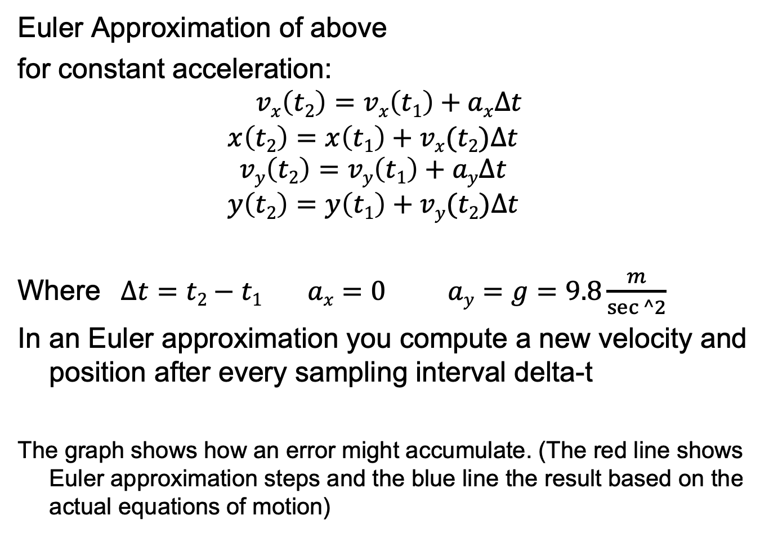
Euler Approximation of Velocity Integral
Euler Approximation of above
for constant acceleration:
$$vx\left(t2\right)=vx\left(t1\right)+ax∆t$$
$$x\left(t2\right)=x\left(t1\right)+vx(t2)∆t$$
$$vy\left(t2\right)=vy\left(t1\right)+ay∆t$$
$$y\left(t2\right)=y\left(t1\right)+vy(t2)∆t$$
Where $∆t=t2−t1 ax=0 ay=g=9.8\frac{m}{sec⁡^2}$
In an Euler approximation you compute a new velocity and position after every sampling interval delta-t
The graph shows how an error might accumulate. (The red line shows Euler approximation steps and the blue line the result based on the actual equations of motion)

Slide 13
What is the object’s displacement?
What will be the horizontal displacement of a ball that is kicked off a 850_{m} cliff at a horizontal velocity of 50_{m/s}?

Slide 14
Displacement along y-component
Account for Vertical motion
Cliff is 850_{m}
Initial speed is 0_{m/s}
The vertical displacement is 850_{m}
How long will it take to reach the bottom of the cliff?
Show Demo

Slide 15
Displacement along the x-component
Compute horizontal displacement
depends on the amount of time that the object is in the air
Show Demo

Slide 16
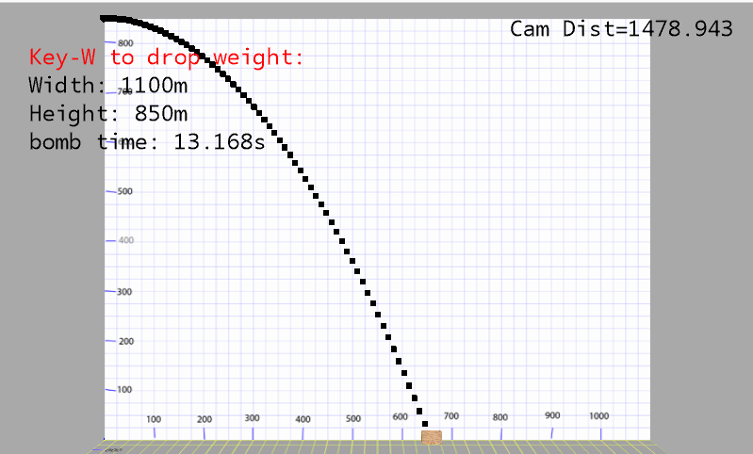
What is the object’s displacement?

Slide 17
Vertical trajectory
Vertical trajectory occurs when the projectile angle is 90º to horizontal
Kicking a ball straight up at 70m/s
How long will the ball be in the air?
What height will the ball reach?
70m/s

Slide 18
How long will the ball be in the air?
The ball will travel up, slowing down, until it stops and then it will start a free fall.
Total time = up time +down time
The ball will stop when its velocity is 0m/s
Corollary - the ball will be in the air twice as long as it takes it to stop

Slide 19
How long will it take the ball to stop?
The ball will be in the air
twice as long – 14.28s (7.14* 2)
Show Demo

Slide 20
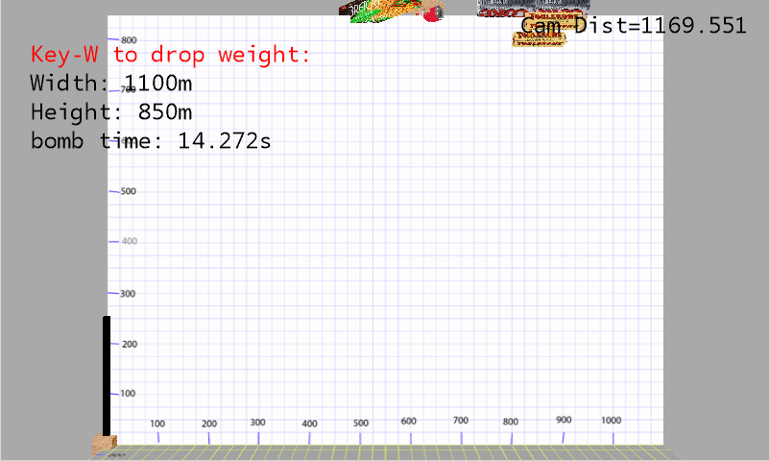
Vertical trajectory
70m/s

Slide 21
How high will the ball go?

Slide 22
Example – javelin throwing
An athlete throws a javelin at 30º degree angle giving it a speed of 70m/s
How far did he throw the javelin?
First compute the time that the javelin is in the air
Using the time compute the distance

Slide 23
Time that the javelin in the air
The javelin is in the air is twice as long as it takes it to reach its maximum height
Show Demo

Slide 24
How far was the javelin thrown?
The throw distance depends on the horizontal displacement (along the x-component)
Show Demo

Slide 25
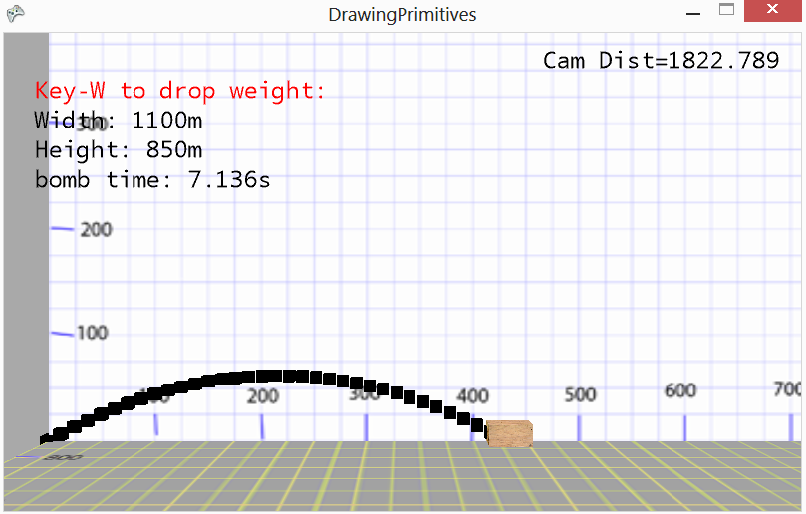
How far was the javelin thrown?
The throw distance depends on the horizontal displacement (along the x-component)
Show Demo

Slide 26
Time that the javelin in the air
This time the javelin is thrown at 30º degree angle giving it a speed of 70m/s off an 850m cliff
The javelin reaches top (0 vertical velocity) in 3.57 seconds
Next compute how high it went.
Show Demo

Slide 27
How high will the javelin go?
Javelin reaches a height of 62.5m above its launch height.
Height from ground is 850 + 62.5 = 912.5m.

Slide 28
How long for the Javelin to fall to ground?
Vertical motion
Cliff is 850_{m}
Initial speed is 0_{m/s}
Total vertical displacement is 912.5_{m}
How long will it take to reach the bottom of the cliff?
Show Demo

Slide 29
How far was the javelin thrown?
The thrown distance depends on the horizontal displacement (along the x-component)
It travels horizontally for the time it is in the air
Show Demo

Slide 30
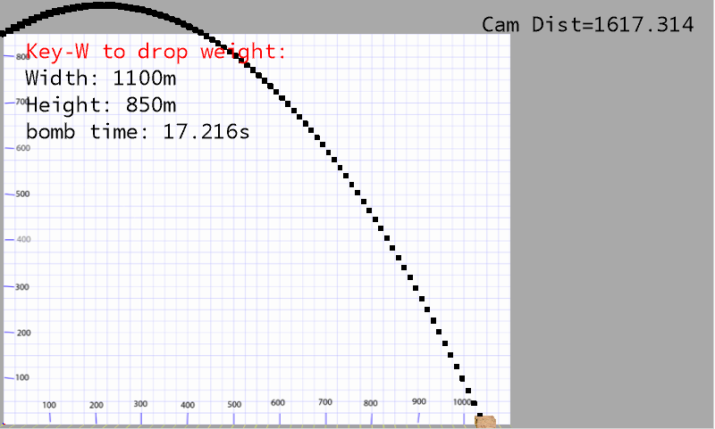
How far was the javelin thrown?

